Slide 1
UFCFB6-30-2 Object-oriented Software Development
Unit 3b Advanced class diagrams
Benedict R. Gaster
2016-17

Slide 2
Outline
Class relationships
Dependency
Association without navigability applied to their association relationship
Aggregation
Composition
Generalization (known as Inheritance)
Abstract classes
Interfaces

Slide 3
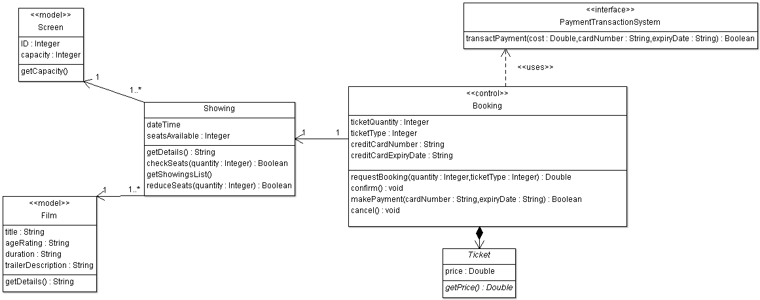
An example of a UWEFlix class diagram

Slide 4
Class relationships

Slide 5
Dependency
A dependency between two classes declares that a class needs to know about another class to use objects of that class.
often used when you have a class that is providing a set of general-purpose utility functions, such as in Java’s mathematics (java.math) packages. Classes depend on the java.math classes to use the utilities that those classes offer.
Notes:
Show example of parameter, and external payment

Slide 6
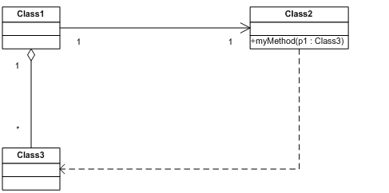
Example of dependency
Accessing service to an external system
A dependency will occur when passing an object type as a method argument.
In this situation a class (class 1) sends a message to another class (class 2) passing a parameter of third type of class (class 3). This is illustrated in the diagram below.

Slide 7
Association without navigability applied to their association relationship
Association means that a class will actually contain a reference to an object, or objects, of the other class in the form of an attribute

Slide 8
The BlogAccount and BlogEntry classes: Java implementation
public class BlogAccount {
// Attribute introduced thanks to the association with the
// BlogEntry class
private BlogEntry[] entries;
// ... Other Attributes and Methods declared here ...
}
public class BlogEntry {
// Attribute introduced thanks to the association with the Blog class
private BlogAccount blog;
// ... Other Attributes and Methods declared here ...
}

Slide 9
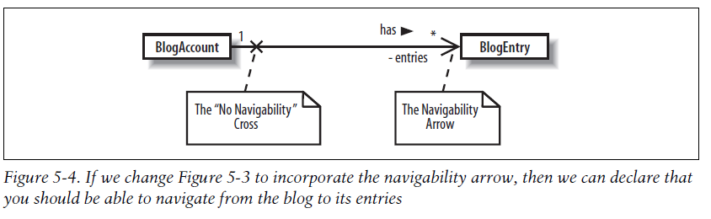
Association with navigability applied to their association relationship

Slide 10
The BlogAccount and BlogEntry classes: Java implementation
public class BlogAccount {
// Attribute introduced thanks to the association with the BlogEntry class
private BlogEntry[] entries ;
// ... Other Attributes and Methods declared here ...
}
public class BlogEntry
{
private BlogAccount blog;
// The blog attribute has been removed as it is not necessary for the
// BlogEntry to know about the BlogAccount that it belongs to.
// ... Other Attributes and Methods declared here ...
}

Slide 11
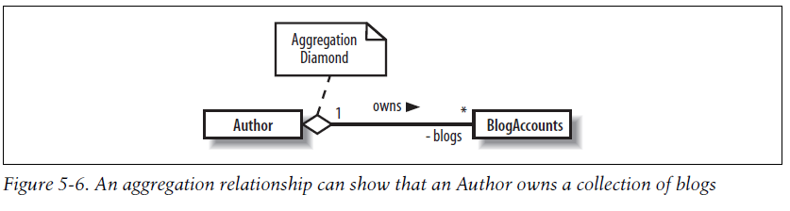
Aggregation
Aggregation is really just a stronger version of association and is used to indicate that a class actually owns but may share objects of another class.
The Java code implementation for an aggregation relationship is exactly the same as the implementation for an association relationship; it results in the introduction of an attribute.
Notes:
Think of other examples

Slide 12
Composition
Composition models the internal parts that make up a class.
Usually be not shared with other parts of the system.
If the “whole” is deleted, then its corresponding parts are also deleted.
Notes:
A blog entry’s introduction and main body sections are actually parts of the blog entry itself and won’t usually be shared with other parts of the system. If the blog entry is deleted, then its corresponding parts are also deleted. This is exactly what composition is all about: you are modeling the internal parts that make up a class.

Slide 13
References
Learning uml 2.0
Uml distilled

